Slide 1
ZENO-MDAKit: Zenowrapper
Jennifer A. Clark

Slide 2
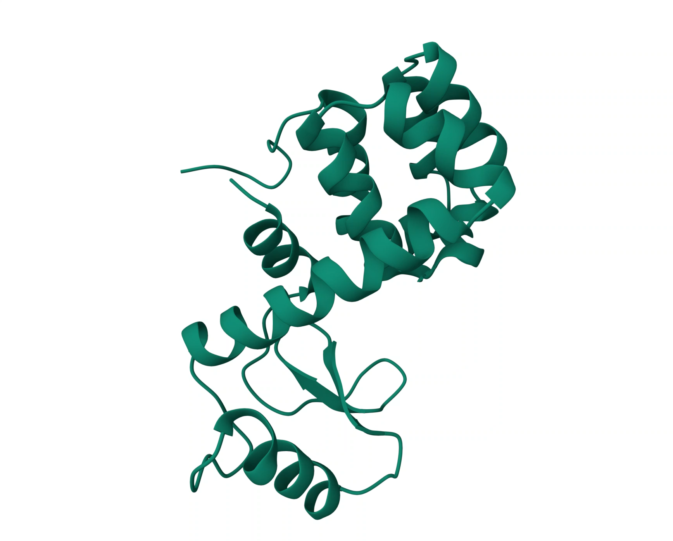

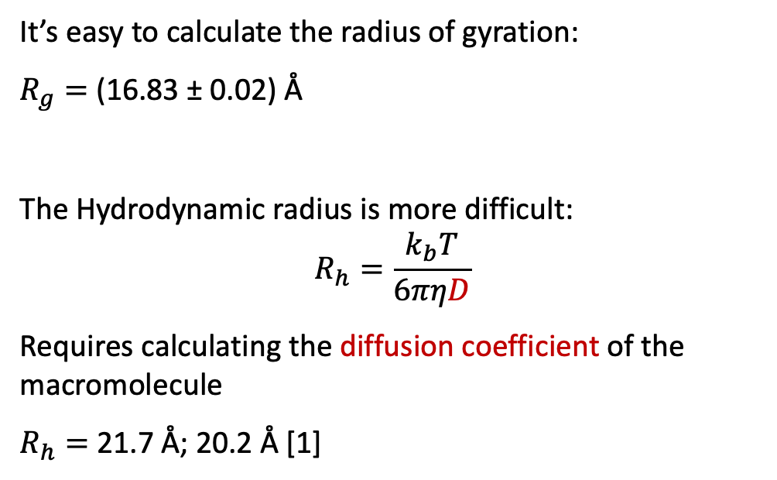
Hydrodynamic Properties of Lysozyme
It’s easy to calculate the radius of gyration:
$R_{g}=$ (16.83 ± 0.02) Å
The Hydrodynamic radius is more difficult:
$$R_{h}=\frac{k_{b}T}{6πηD}$$
Requires calculating the diffusion coefficient of the macromolecule
$R_{h}=$ 21.7 Å; 20.2 Å [1]
What if you could calculate $R_{h}$ in less than a minute?
[1] Grisham & Nanda. Proteins: Structure, Function, and Bioinformatics 86, no. 5 (2018): 515–23. DOI: 10.1002/prot.25469

Slide 3
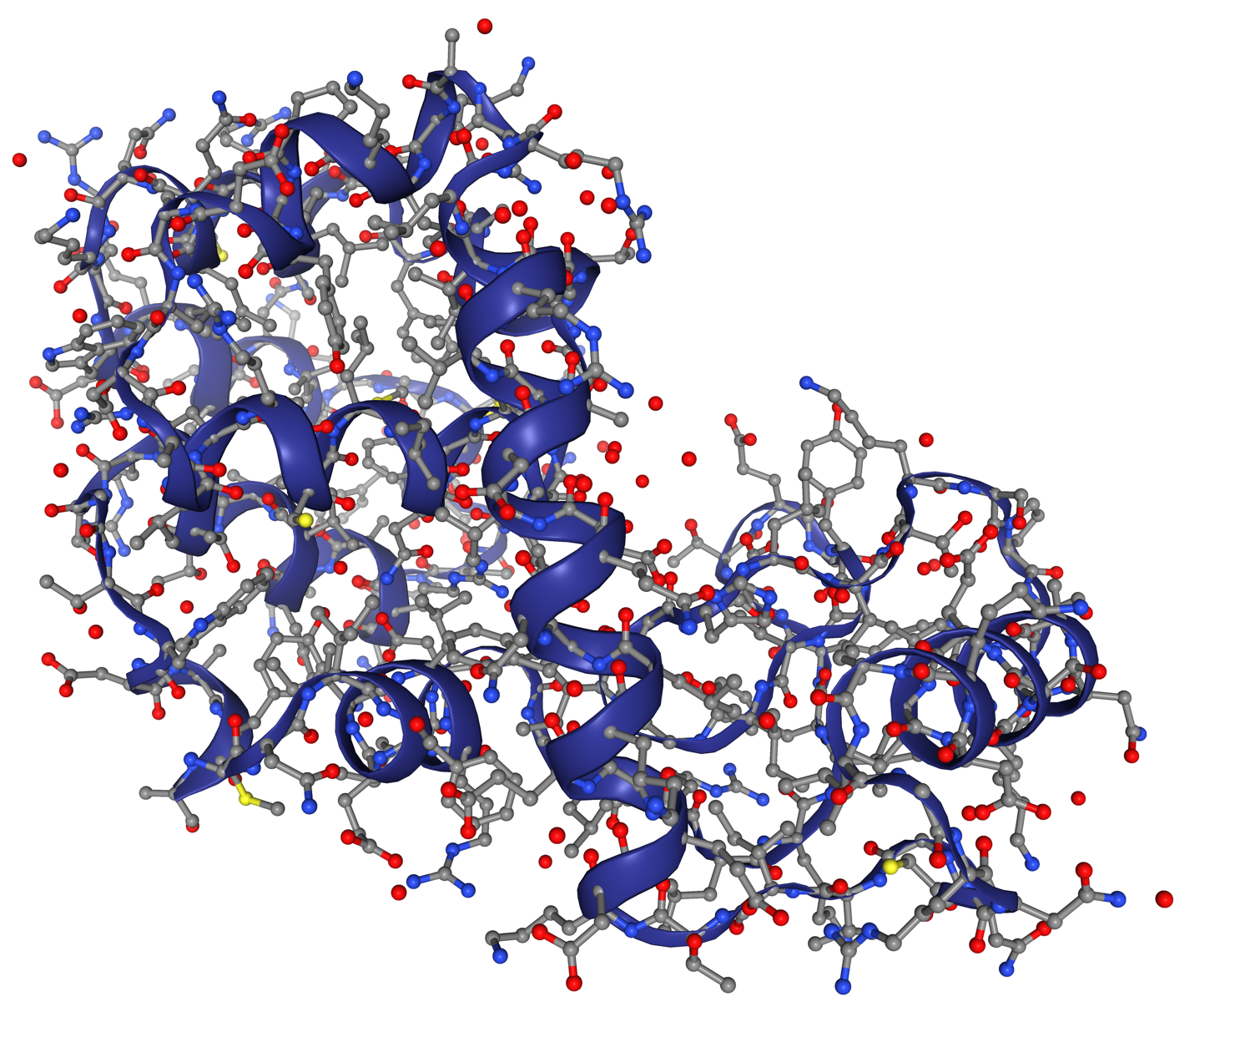
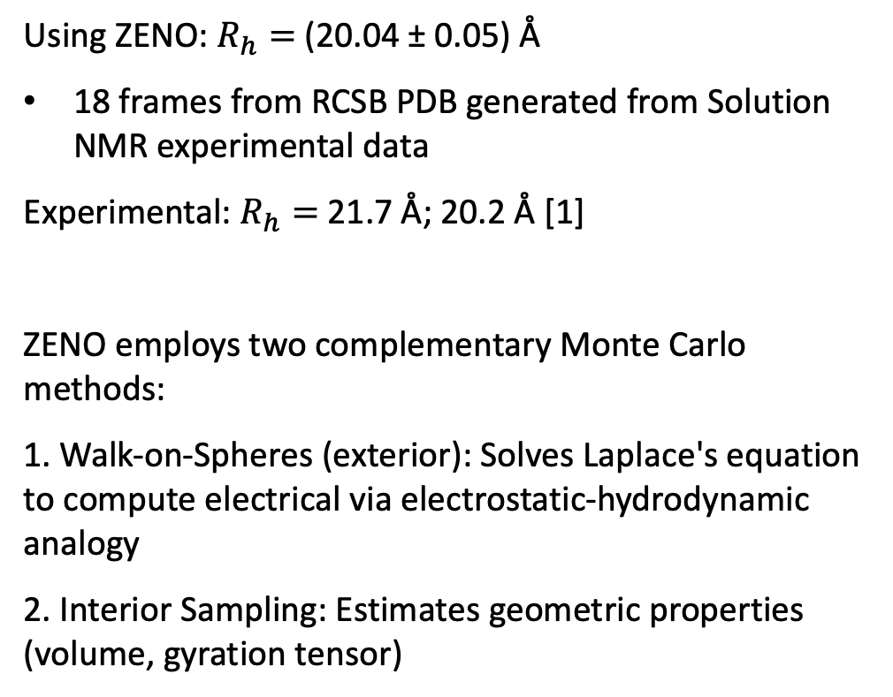
Hydrodynamic Properties of Lysozyme
RCSB PDB
Using ZENO: $R_{h}=$(20.04 ± 0.05) Å
18 frames from RCSB PDB generated from Solution NMR experimental data
Experimental: $R_{h}=$ 21.7 Å; 20.2 Å [1]
ZENO employs two complementary Monte Carlo methods:
1. Walk-on-Spheres (exterior): Solves Laplace's equation to compute electrical via electrostatic-hydrodynamic analogy
2. Interior Sampling: Estimates geometric properties (volume, gyration tensor)
[1] Grisham & Nanda. Proteins: Structure, Function, and Bioinformatics 86, no. 5 (2018): 515–23. DOI: 10.1002/prot.25469

Slide 4
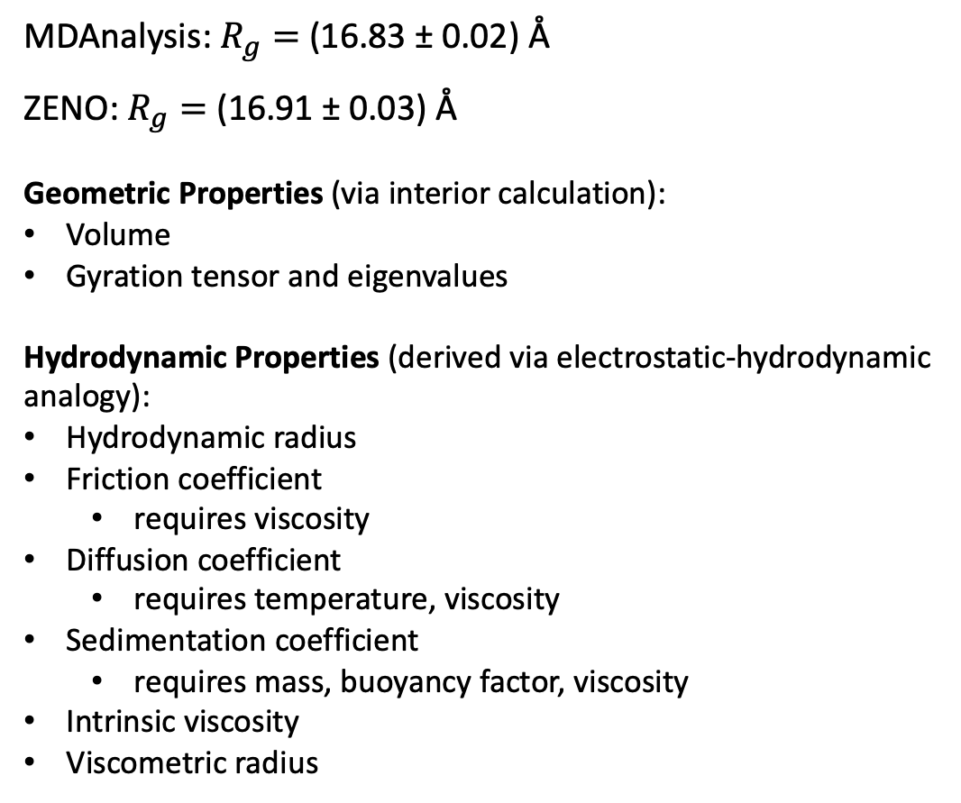
Hydrodynamic Properties of Lysozyme
RCSB PDB
MDAnalysis: $R_{g}=$ (16.83 ± 0.02) Å
ZENO: $R_{g}=$ (16.91 ± 0.03) Å
Geometric Properties (via interior calculation):
Volume
Gyration tensor and eigenvalues
Hydrodynamic Properties (derived via electrostatic-hydrodynamic analogy):
Hydrodynamic radius
Friction coefficient
requires viscosity
Diffusion coefficient
requires temperature, viscosity
Sedimentation coefficient
requires mass, buoyancy factor, viscosity
Intrinsic viscosity
Viscometric radius

Slide 5

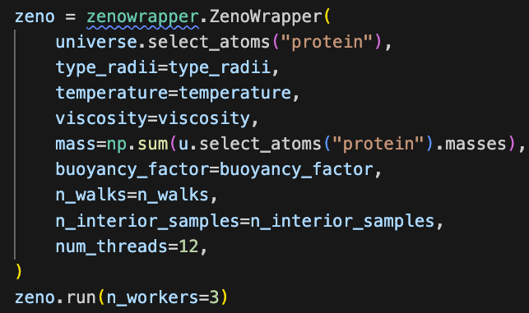
ZenoWrapper
Optionally include solvent properties for additional properties
Parallelize using:
Existing Python MDAnalysis AnalysisBase of simultaneous processing of frames
C++ ZENO parallelization of random walks within a frame
Compatible with streaming

Slide 6
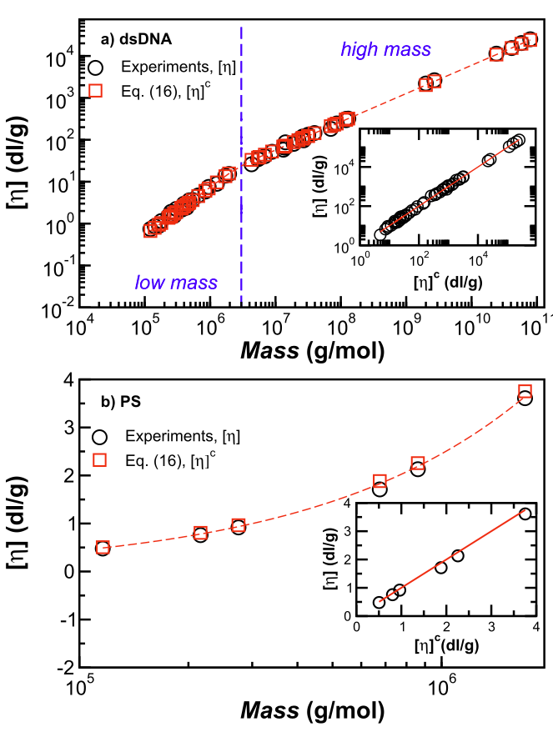
ZENO in the Literature
Hydrodynamic measurements of size deviate from geometric estimates of particle size when the particle or polymer shape is complex
Notice the overlap between experiments and estimates from simulation trajectory processed with ZENO for the intrinsic viscosity of [1]:
Double stranded DNA
Polystyrene in toluene
[1] Vargas-Lara, Mansfield, and Douglas. Journal of Chemical Physics 147 (2017): 014903. DOI: 10.1063/1.4991011

Slide 7
ZENO in the Literature
Hydrodynamic measurements of size deviate from geometric estimates of particle size when the particle or polymer shape is complex
Notice the overlap between experiments and estimates from simulation trajectory processed with ZENO for the intrinsic viscosity of [1]:
Double stranded DNA
Polystyrene in toluene
[1] Vargas-Lara, Mansfield, and Douglas. Journal of Chemical Physics 147 (2017): 014903. DOI: 10.1063/1.4991011

Slide 8
Thank You
Project Members:
Derek Juba
Walid Keyrouz
Debbie Audus
Jack F. Douglas
Acknowledgments:
Ian Bell
Soon to be found at: https://github.com/usnistgov/zenowrapper
Contact Information:
Email: jennifer.a.clark13@gmail.com

